Slide 1
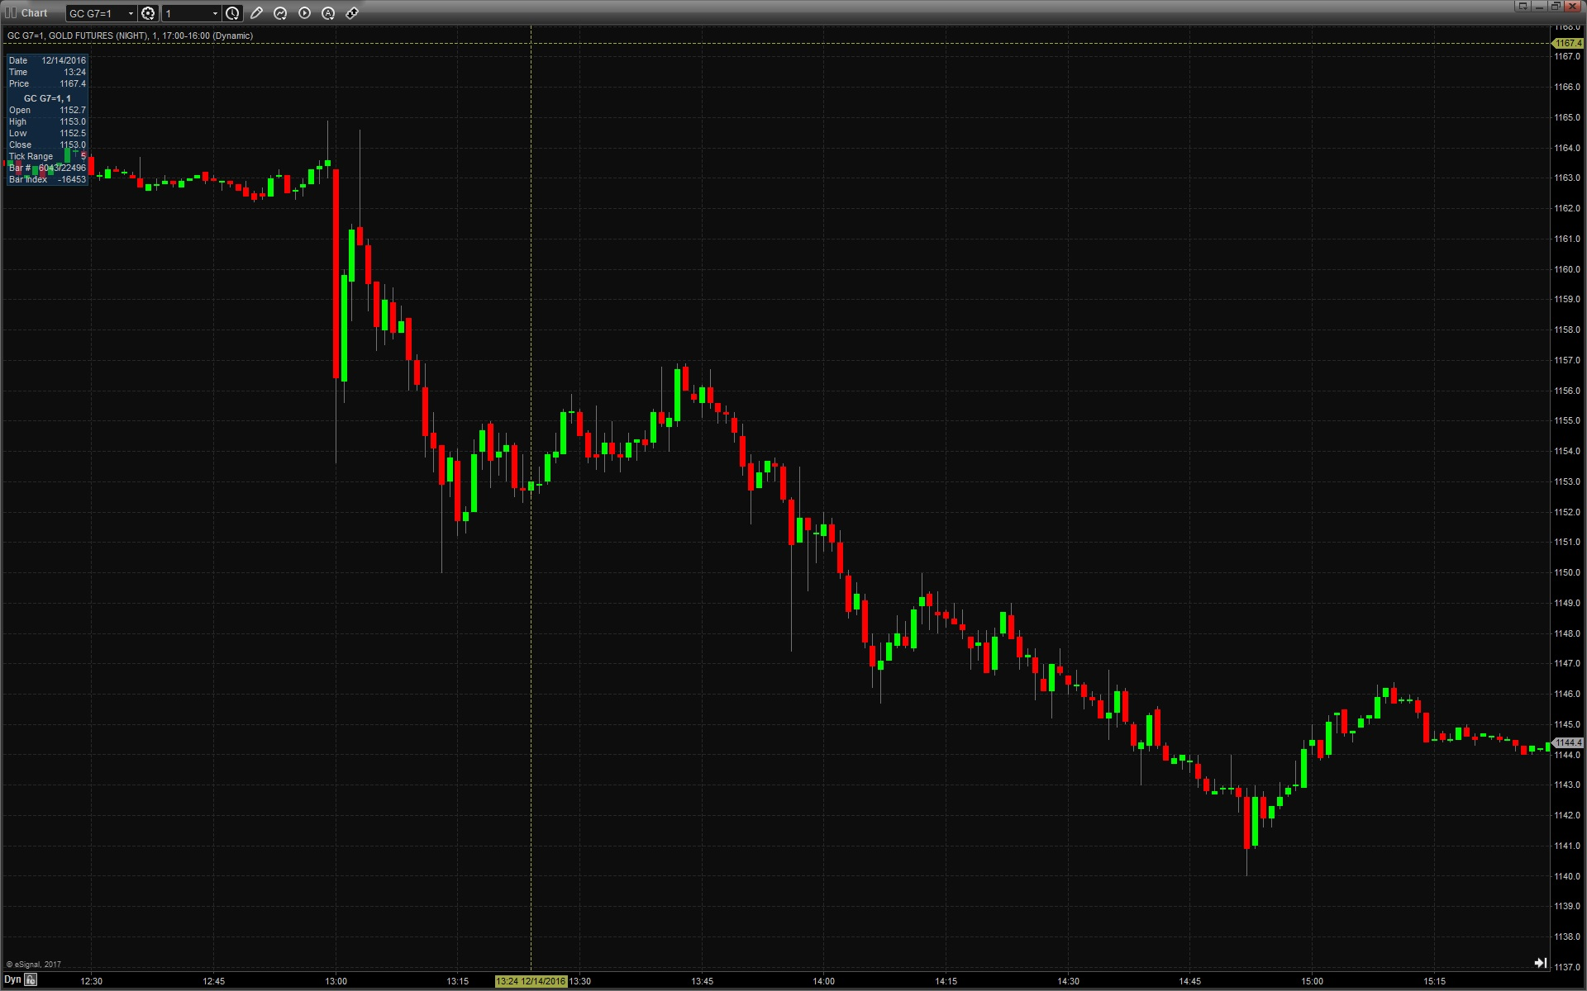
Trading FOMC 12/14/16
A look at ZN, ES, 6E and GC

Slide 2
What is the Federal Reserve?
Federal Reserve System was established by Congress in 1913 to oversee monetary system as well as economic activity throughout the country. All nationally charted banks are members and hold reserves balances at the Fed.
The system is comprised of a Board of Governors and 12 Reserve Banks throughout the country (Boston, New York, Philadelphia, Cleveland, Richmond, Atlanta, Chicago, St. Louis, Minneapolis, Kansas City, Dallas, and San Francisco)
Federal Open Market Committee (FOMC) is the policy making board of the Federal Reserve System. The committee has a dual mandate of maximum employment and stable prices (inflation)
Typically uses overnight interest rates to conduct policy
Supervise and regulate banks within the financial system. Produce regional reports on economic activity.

Slide 3
Federal Open Market Committee
Stanley Fisher – Vice Chairman
William Dudley-NY Fed President
5 Remaining Board of Governors
4 of 11 remaining Reserve Bank Presidents
(rotating)
FOMC
12 members
Janet Yellen -Chairwoman

Slide 4
FOMC Meeting Structure
FOMC meets 8 times per year, usually 6 weeks apart. Releases minutes 3 weeks afterwards
Rate decision, statement and projections released at 1pm
Chairperson’s press conference begins 30 minutes later
Each quarter, the meetings include economic projections and a press conference

Slide 5
Expectations vs Outcome
The market will react to the difference between expectations and outcome
Ahead of the December 14 decision, markets had a 25 bp hike completely priced in
The reaction came from the surprise in the increase in the “dot plot”
Yellen’s press conference did little to stop the momentum in the market

Slide 6
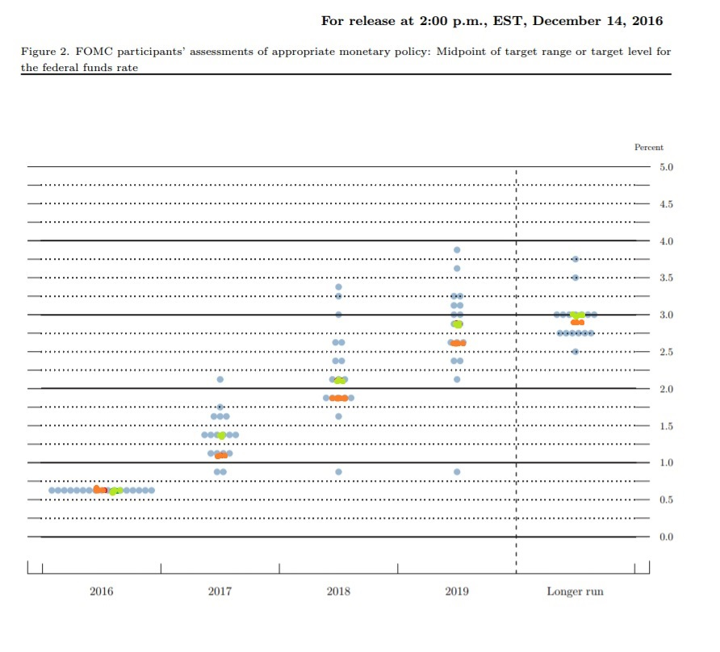
What mattered in December

Slide 7
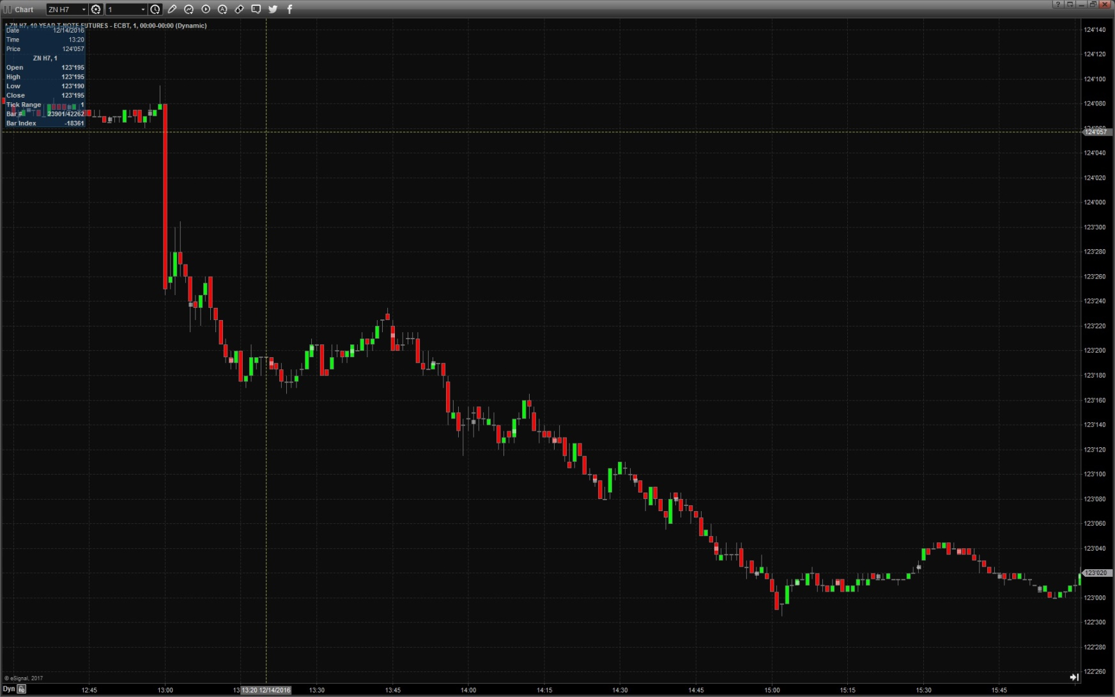
ZN H7 - US Ten Year Futures

Slide 8
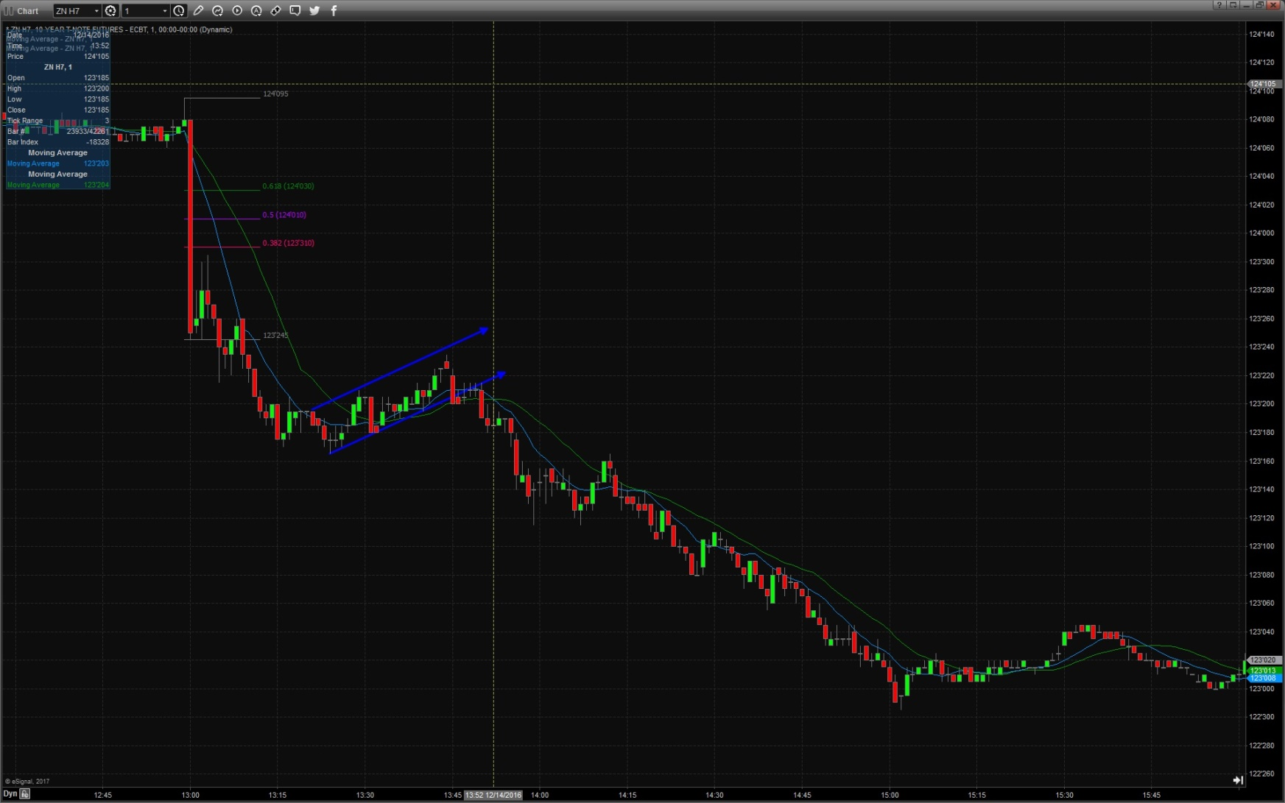
ZN H7 - US Ten Year Futures

Slide 9
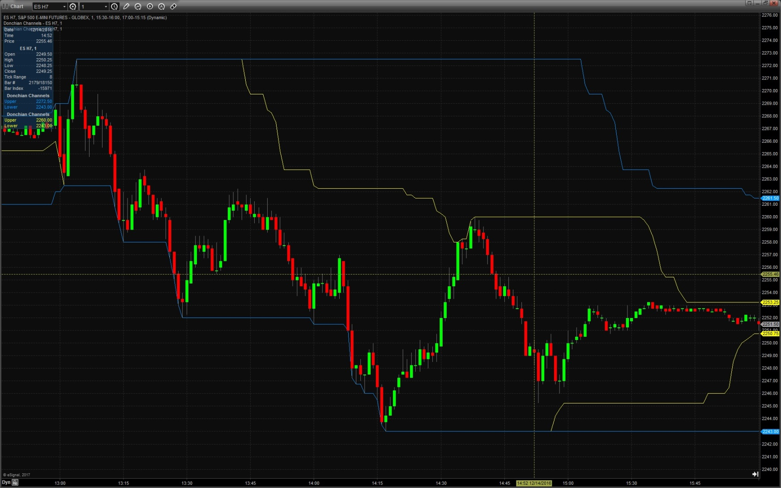
ES H7 – S&P 500 Futures

Slide 10
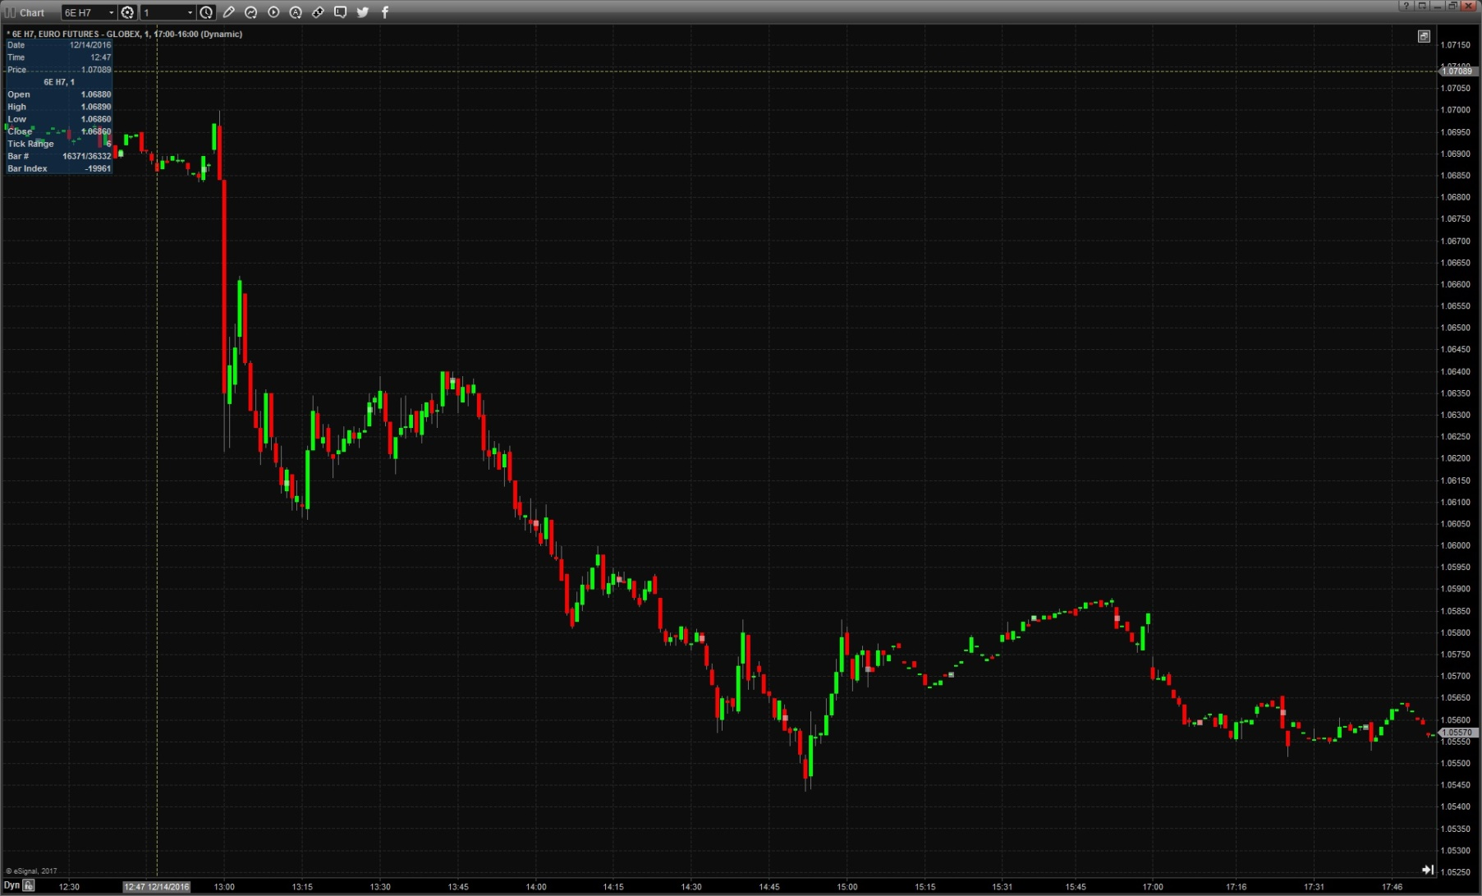
6E H7 – Euro Currency Futures

Slide 11
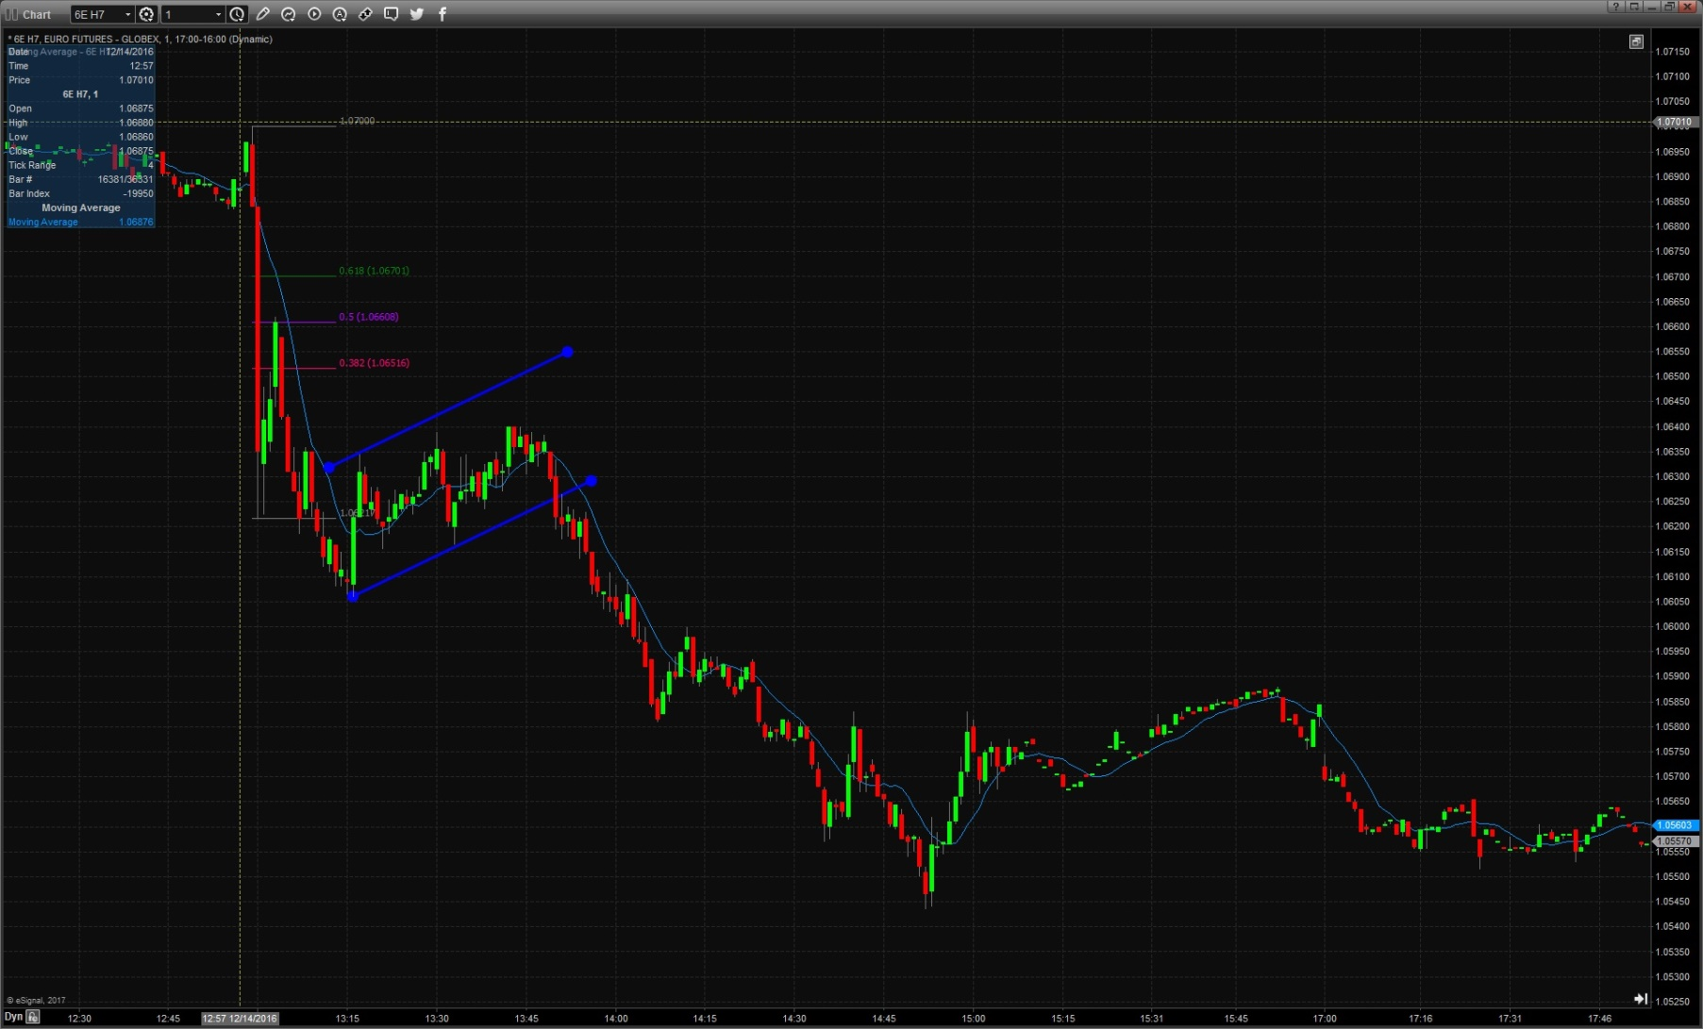
6E H7 – Euro Currency Futures

Slide 12
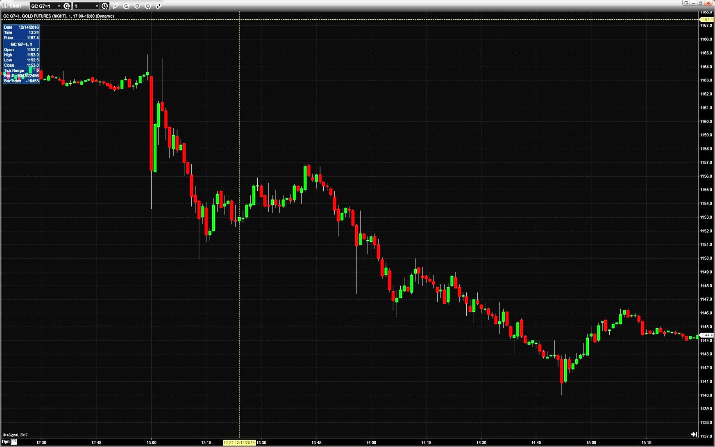
GC G7 – Gold Futures

Slide 13
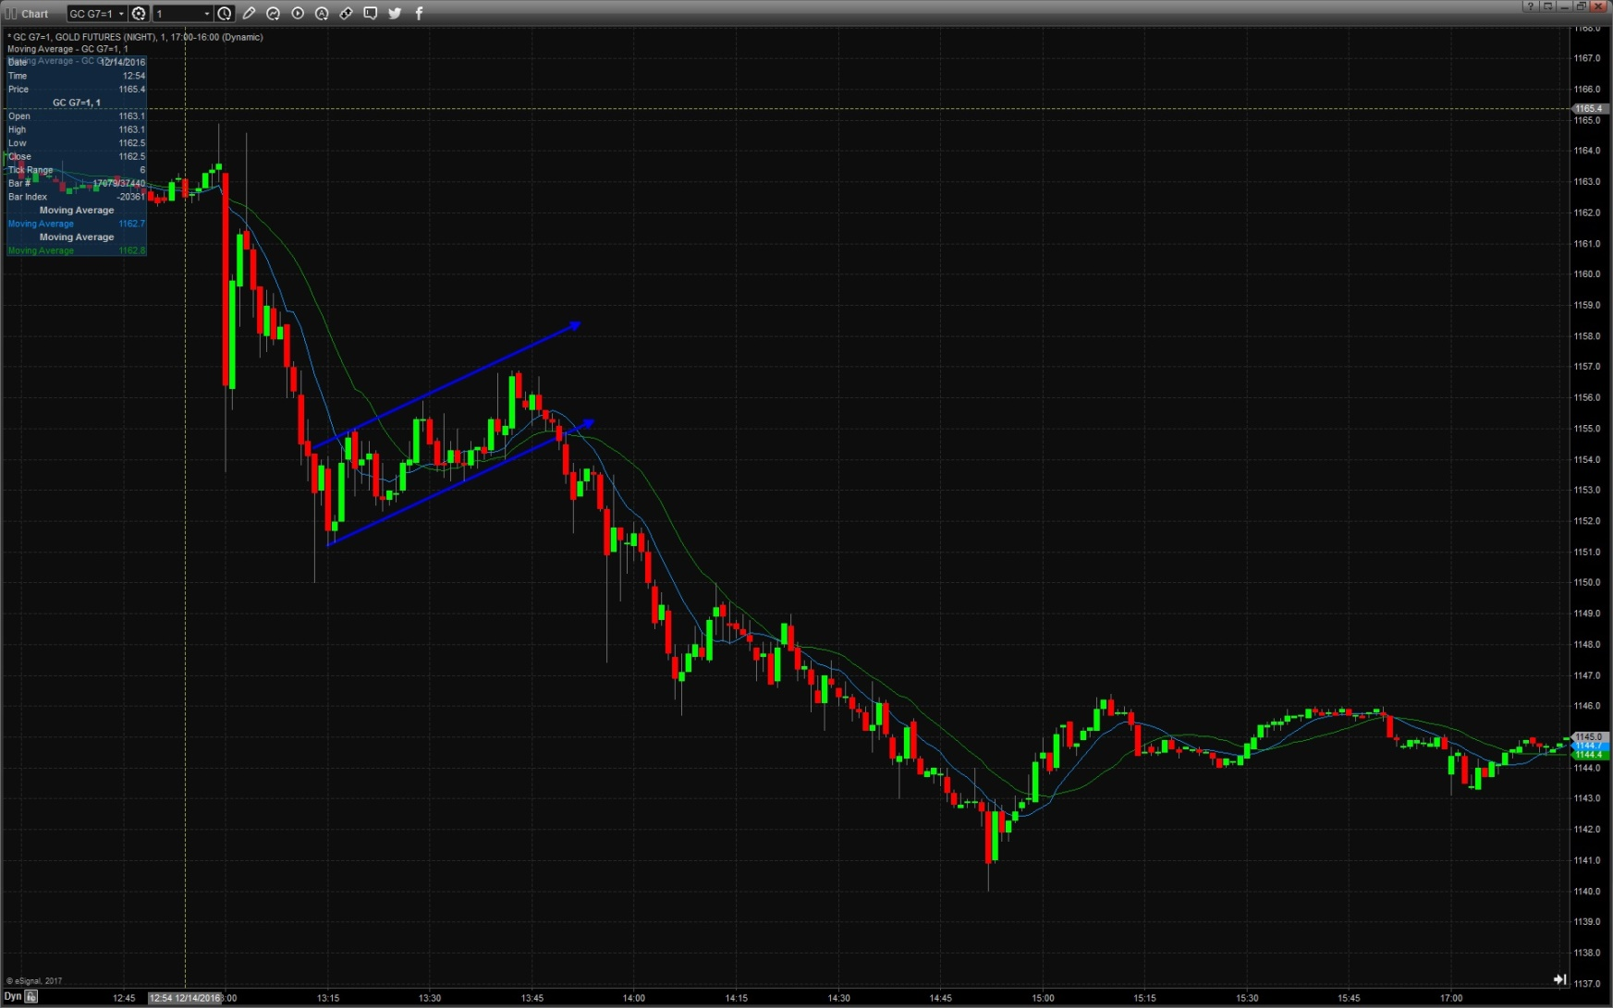
GC G7 – Gold Futures

Slide 14
Conclusions
Understanding the data and expectations
Interpreting the actual outcome
Finding value in the markets
Executing your ideas
What parts of the process can become automated?

